Slide 1
Rhode Island Health Insurance Survey (HIS):
2020 Executive Summary Report
Freedman HealthCare
January 14, 2021

Slide 2
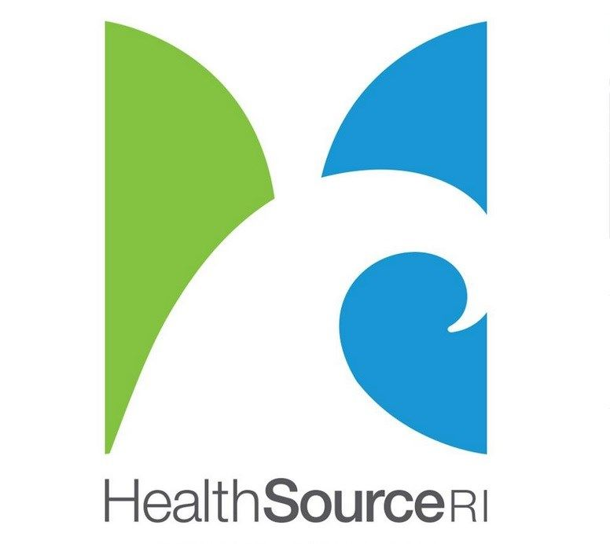
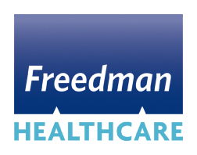
Table of Contents
SECTION PAGE #
Introduction 1
Report Highlights 2
Demographic Overview 3
Coverage Trends 4
The Uninsured Population 5
State Mandate 18
The Underinsured Population 19
Cost of Care 24
Impact of Cost on Access 29
Glossary 30
Appendix 31

Slide 3
SECTION 1. Introduction
The Rhode Island Health Information Survey (RI HIS)
The RI HIS collects information on Rhode Islanders’ insurance status, healthcare costs, experience getting care, use of medical services, and relevant demographic variables.
Five separate surveys were conducted via land-lines and cell phones between July and October 2012¹, March and June 2015, June and September 2016, June and December 2018, and April and September 2020.² Surveys were conducted in English and Spanish.
Market Decisions Research conducted the surveys on behalf of the Rhode Island Executive Office of Health and Human Services (EOHHS) and HealthSource RI (HSRI). Freedman HealthCare provided project management and analytic support.
The respondent sample was drawn from RI residents, excluding those in institutional settings (e.g. jails and hospitals), group quarters (e.g. dormitories and military barracks), and non-permanent residences.
In 2020, a total of 7,354 residents were interviewed from 3,000 households.
Results were weight adjusted and normalized to the actual Rhode Island state population distribution using demographic information and population counts from the Census Bureau’s American Community Survey, as well as plan enrollment and benefits data from HSRI.³
This Report
The Executive Summary Report highlights key findings from the data regarding the uninsured population, the underinsured population, Medicaid and HSRI enrollment, and cost of care and access.
Findings are based on data from the 2012, 2015, 2016, 2018, and 2020 surveys.
Select demographic analyses are limited by the relative size, diversity, and populations of Rhode Island’s counties. Some trend analyses are limited by the available years of data.
The intent of this report is to guide dialogue on potential areas of future data and policy analyses. This report does not include operational and policy recommendations.
¹ The first survey was conducted pre-Medicaid expansion. See ‘Glossary’ for additional information on the impact of the ACA in Rhode Island.
² The COVID-19 pandemic hit the U.S. in March 2020. Where appropriate, as in prior years, respondents were explicitly asked to answer many questions based upon their
experiences over the past 12 months, not just during the pandemic. Despite these instructions, it is important to note that some responses may be unconsciously biased
by the pandemic which has had a profound impact upon most communities.
³ It is important to note that sample sizes are reduced when we slice the data by additional variables, e.g. year and age group. This widens the margin of error and
not all observed changes are necessarily statistically significant. We present this data to show directional trends; it should not be over-interpreted.
Notes:
General Notes:
The sample size and sampling methodology employed in 2020 yields a dataset that is comparable to prior years’ surveys in terms of population size, confidence intervals, comparisons of significance, and analytic power.
Important to contextualize any shifts in trends from 2018 to 2020 with the COVID-19 pandemic in mind…
The pandemic first hit the U.S. in March 2020
The survey was conducted in April through September 2020
As such, the 2020 data likely captures and reflects some of the broader impacts of COVID (e.g. potential loss of employment which an individual’s and their household’s coverage may be tied to, perceptions of the importance of coverage, and healthcare access and utilization trends). At this time, the full and longer-term impacts of the pandemic are not yet known.
A few new questions were added to the survey this year to gauge the preliminary impact of the pandemic on coverage. The findings are included in this report.
For specific questions (e.g. those related to healthcare access, cost, and utilization), respondents were explicitly asked to answer based upon their experiences over the past 12 months, not just during the pandemic. This is in alignment with how the questions were framed in prior years. Despite these instructions, it is important to note that some responses may be unconsciously biased by the pandemic which has had a profound impact on most.
It is important to note that sample sizes are reduced when we slice the data by additional variables, e.g. year and age group. This widens the margin of error and
not all observed changes are necessarily statistically significant. We present this data to show directional trends; it should not be over-interpreted.

Slide 4
SECTION 2. Report Highlights, 2020
Important caveats
All shifts in trends from 2018 to 2020 should be contextualized with the COVID-19 pandemic in mind.
Sample sizes are reduced when we slice the data by additional variables such as age or race. This widens the margin of error and not all observed changes are necessarily statistically significant. We present this data to show directional trends; it should not be over-interpreted.
The uninsured rate in Rhode Island rose by 0.3 points in 2020 (which is statistically unchanged from the prior survey year), after steadily declining from 10.9% in 2012, to 4.8% in 2015, to 4.2% in 2016, and 3.7% in 2018.
The majority of the uninsured population were non-elderly adults, childless, of good to excellent health, and were employed part or full-time. Males, Hispanic/Latinos, racial minorities, and foreign-born residents are overrepresented among the uninsured.
For the first time since 2012, the uninsured rate in RI rose among households with an annual income of under 139% FPL and between 250 to 400% FPL.
Unaffordable premiums and job loss were the most common reasons for being uninsured.
The underinsured rate fell from 30.4% in 2018 to 25.1% in 2020.
Nearly all income groups experienced a decreased rate of underinsurance. The exception was individuals with household incomes of below 139% FPL.
While the national underinsurance rate held steady for work-based insurance and increased among those with direct purchase coverage, the state’s underinsured rate dropped across both sources of private coverage.
Average monthly premium costs and out-of-pocket medical expenses fell, while deductible costs remained fairly stable.
74% of insured residents paid a monthly premium of $500 or less, in comparison to 59% in 2018.
47% of insured residents paid an annual deductible of $2,000+, the same as in 2018.
The average out-of-pocket spend for medical expenses dropped to $2,124, likely in part due to a general decline in use of non-urgent clinical services during the COVID-19 pandemic.
The portion of individuals with HSAs continued to grow, with individual HSA contributions on average modestly increasing and employer contributions on average not significantly changing.
The proportion of residents who reported foregoing care because they could not afford it dropped
across all care types, except for mental health care. This rate remained unchanged at 1.6%.

Slide 5
SECTION 3. Demographic Overview
Rhode Island Demographics, July 2019¹
Race: 70.8% of the RI population identified as non-Hispanic White compared to 60.0% of the US population, 9.6% as Black or African American compared to 12.8% nationally, 4.5% as Asian compared to 5.7% nationally, and 1.3% as American Indian/Alaska Native compared to 0.9% nationally.
Ethnicity: Hispanics and Latinos comprised a smaller proportion of the RI population (16.3%) than nationally (18.4%)
Foreign Born: In alignment with the national rate, 13.7% of Rhode Islanders were born outside of the US.
Income: The median household income among Rhode Islanders was $71,169 compared to the US median household income of $65,712. RI’s poverty rate was 10.8% compared to the US poverty rate of 12.3%.
Seniors: The average age of RI’s population exceeded the US’ average. Adults ages 65 or above made up 17.7% of RI’s population, compared to 16.5% of the US population.
Children: Children under 18 years made up 19.2% of the state’s population, compared to 22.2% of the US population.
Gender: 51.2% of Rhode Islanders identified as female, compared to 50.8% of the US population.
Population Growth: RI’s population grew by a slower rate from 2010 to 2019. Over this period, RI grew by 0.6% whereas the national population increased by 6.3%. In 2019, the estimated number of residents in Rhode Island was 1,059,364.
¹Data Source: US Census Bureau. 2020 statistics not yet available as of November 2020. Prior year’s statistics are provided as
proxies.
Notes:
Key Findings:
General trends across the U.S. from 2018 to 2019:
Average age is up, median household income is up, poverty rate is down
We see similar trends locally in RI
As in past years – in comparison to the US population – the RI population has:
A higher average age; the percent of adults age 65 or older rose from 16.8% in 2018 to 17.7% in 2019,
With a smaller proportion of Hispanic/Latinos and a higher percentage of non-Hispanic White residents, and
A higher median household income
General Notes:
Additional races in RI not listed above: Native Hawaiian/Pacific Islander = 0.3%, Other (non-specific) = 6.9%
Source of national and state statistics: US Census Bureau (https://data.census.gov/cedsci/?q=United%20States)

Slide 6
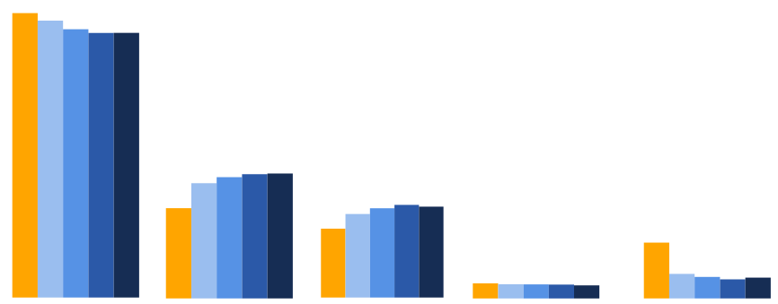
SECTION 4. Coverage Trends
Across the nation, the health insurance coverage landscape is shifting as a result of the COVID-19 pandemic
While the full impact of this public health crisis is not yet known, current data indicates increased rates of mortality among the elderly and lower-income communities, as well as increased rates of unemployment leading to shifts in government-sponsored and employer-sponsored insurance rates.
There has been minimal change to coverage in Rhode Island, as of the time of the 2020 Health Insurance Survey.
55.4%
53.9%
Enrollment by Insurance Type
52.2%
51.5%
51.5%
Enrollment by Insurance Type (count)
Insurance | 2012 | 2015 | 2016 | 2018 | 2020
Private | 574,863 | 559,954 | 544,558 | 539,630 | 538,611
Medicaid | 182,394 | 233,017 | 246,100 | 253,353 | 254,206
Medicare | 139,162 | 168,911 | 181,199 | 188,935 | 184,938
Military | 29,177 | 27,458 | 27,288 | 27,035 | 25,463
Uninsured | 112,774 | 49,591 | 43,609 | 38,887 | 42,305
State Total | 1,038,370 | 1,038,930 | 1,042,754 | 1,047,840 | 1,045,523
23.6%
24.2%
24.3%
22.4%
17.6%
17.4%
18.0%
17.7%
16.3%
13.4%
10.9%
4.8%
4.2%
4.0%
2.8%
2.6%
3.7%
2.6%
2.6%
2.4%
Private Insurance Medicaid Medicare Military Uninsured
Notes:
Key Findings:
From 2012 through 2018, RI’s uninsured rate continued to decline with increasing reliance on public payers for coverage. Medicare and Medicaid coverage rates steadily increased, as the rate of private insurance has decreased.
In 2020 we see a very slight shift in trends across the board, which we hypothesize are linked to the COVID-19 pandemic to some extent.
Given the confidence intervals, current shifts are not all statistically significant.
These changes while small at this juncture may be indicative of larger unfolding changes over the months to come. We advise keeping an eye on these shifts via other, more timely datasets available to the State.
Potential reason for slight drop in Medicare and Military coverage rates: An aging population and increase in elderly mortality rates due to COVID. Significant portion of those covered by Military insurance are older veterans.
‘Military’ insurance is defined as military, Veterans, or TRICARE (formally known as CHAMPUS) insurance.
Potential reason for slight rise in uninsured rate: Loss of employment due to COVID and employer-sponsored insurance (ESI). Data suggests a portion of those who lost ESI may have been able to re-secure coverage through Medicaid or the state health exchange. Plans purchased through HSRI are categorized as ‘private’ insurance.
General Notes:
Chart denominator: all Rhode Island residents
Beginning in 2014, the ACA expanded coverage to millions of previously uninsured people through the expansion of Medicaid and the establishment of State Health Insurance Exchanges, i.e. HSRI. The 2012 data provides a snapshot of coverage trends in RI before Medicaid expansion.
Projections from Robert Wood Johnson (RWJ) published in May 2020 on COVID, rising rates of unemployment, and impact on health insurance coverage across the nation: https://www.rwjf.org/en/library/research/2020/05/how-the-covid-19-recession-could-affect-health-insurance-coverage.html

Slide 7
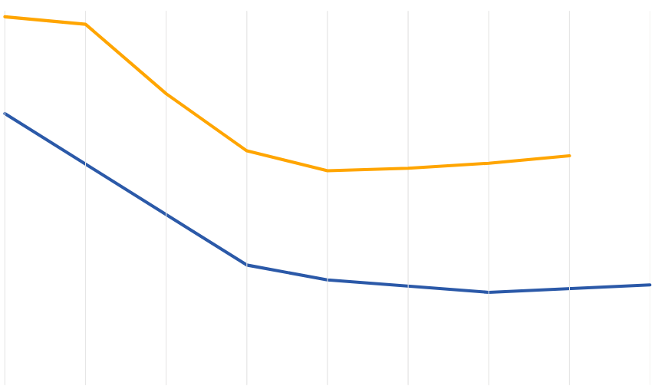
SECTION 5. The Uninsured Population
Across all years of comparison, RI’s uninsured rate has remained well below the national rate
Drops in the State’s uninsured rate post-ACA implementation were sustained through 2018.
From 2018 to 2020, Rhode Island’s uninsured rate rose by 0.3 points, the same increase that was seen nationally from 2018 to 2019 alone (pre-pandemic).
National vs. Rhode Island Uninsured Rates
14.8%
14.5%
Total Uninsured in RI
11.7%
Year | Count
2012 | 112,774
2015 | 49,591
2016 | 43,609
2018 | 38,887
2020 | 42,305
10.9%
9.4%
8.9%
9.2%
8.6%
8.7%
4.8%
4.2%
3.7%
4.0%
3.7%
2012 2013 2014 2015 2016 2017 2018 2019 2020
National Statistic Source: US Census Bureau; 2020 rate was not yet available as of November 2020
Notes:
Key Findings:
Despite the recent rise in RI’s uninsured rate, it is still trending to be well below the national rate
From 2018 to 2020, the RI uninsured rate rose by 0.3 points, the same increase that was seen nationally from 2018 to 2019 alone (pre-COVID)
General Notes:
Chart denominator: all Rhode Island residents
Source of national uninsured rates: Center on Budget and Policy Priorities and the US Census Bureau (https://www.cbpp.org/research/health/uninsured-rate-rose-again-in-2019-further-eroding-earlier-progress)

Slide 8
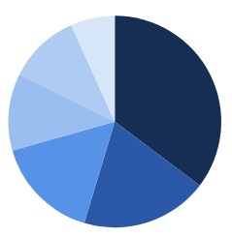
Demographic Characteristics of the Uninsured
Males, childless adults, and parents were overrepresented among the uninsured in 2020
The majority of the uninsured population were of good to excellent health and had a high school or more advanced degree. Over half of the uninsured population were employed part or full-time.
Uninsured Population, 2020
Gender County Family Type
Washington
5.9%
Bristol
2.5%
Elders 2.5%
Other
8.6%
Children
10.5%
Black
12.4%
Newport
6.7%
Female
40.8%
Kent
10.9%
Childless Adults
54.2%
Male
59.2%
Providence
74.0%
Parents
32.8%
Health Status Work Status Education Level
Poor 3.8%
Other 0.4%
College Grad
6.7%
Fair
12.2%
Fair
8.6%
Employed Part-Time
15.6%
Excellent
24.1%
Some College
10.9%
Employed
Full-Time
43.7%
High School Grad
35.3%
Good
36.0%
< 18yo
11.8%
Good
31.2%
Very Good
28.7%
Not Working
40.3%
Post Grad Degree
16.0%
Less than HS
19.3%
Total Uninsured (count): 42,305
Notes:
Key Findings:
As in 2018, the majority of the uninsured population in RI were male, lived in Providence County, were childless adults, of good to excellent health, had a high school, college, or graduate degree, and were employed part or full time.
Over-represented groups. In 2020…
~59% of the uninsured pop is male, whereas only ~49% of all Rhode Islanders identified as male
~54% of the uninsured pop are childless adults, whereas only ~40% of Rhode Islanders are childless adults
~33% of the uninsured pop are parents, whereas only ~22% of Rhode Islanders are parents
In comparison to 2018, the percent of uninsured who were…
Parents increased by 13.2 points – perhaps due to loss of job and ESI related to COVID pandemic?
Female increased by 4.2 points
Living in Providence County rose by 2.5 points, and living in Kent county increased by 3 points
Not working increased by 3.8 points
General Notes:
Chart denominator: all uninsured in Rhode Island
2012, 2015, 2016, and 2018 statistics are not shown on this slide, but are available in the interactive dashboards
Subsequent slides provide a deeper dive into the uninsured rate among different age, race, ethnicity, and place of birth groups, allowing for an analysis of year-over-year trends among these specific demographic groups

Slide 9
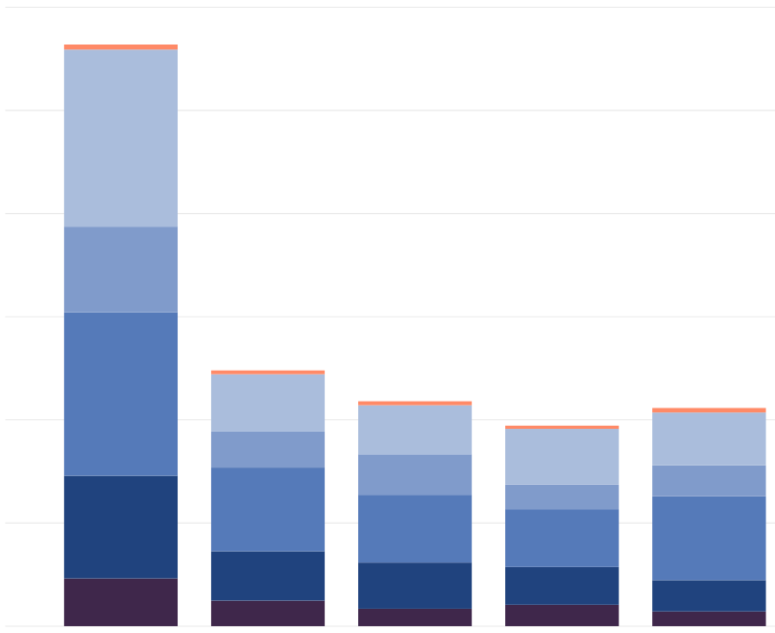
Uninsured Rate By Age
From 2018 to 2020, the uninsured rate among non-elderly adults rose by 3.6 points
As in prior, post ACA years, the uninsured rate remained the highest among adults aged 26 to 35 years.
While the overall uninsured rate rose in 2020, the uninsured rate among children and young adults aged 18 to 25 both declined.
Percent of Uninsured Population by Age Group
Denominator: total # uninsured per year
0.9%
Uninsured by Age Group (count)
Age (yrs) | 2012 | 2015 | 2016 | 2018 | 2020
65 + | 975 | 734 | 763 | 615 | 873
45 to 64 | 34,331 | 11,127 | 9,502 | 10,857 | 10,230
36 to 44 | 16,617 | 6,973 | 7,859 | 4,737 | 6,004
26 to 35 | 31,683 | 16,217 | 13,141 | 11,203 | 16,269
18 to 25 | 19,903 | 9,580 | 8,956 | 7,320 | 6,071
0 to 17 | 9,265 | 4,959 | 3,387 | 4,155 | 2,858
Total | 112,774 | 49,590 | 43,608 | 38,887 | 42,305
30.4%
14.7%
1.5%
28.1%
22.4%
1.7%
2.1%
Age Group
21.8%
1.6%
65+
45 to 64
36 to 44
26 to 35
18 to 25
0 to 17
14.1%
27.9%
24.2%
18.0%
12.2%
14.2%
17.6%
32.7%
30.1%
28.8%
38.5%
19.3%
20.5%
18.8%
14.4%
8.2%
10.0%
7.8%
10.7%
6.8%
2012 2015 2016 2018 2020
Notes:
Key Findings:
Potential reason why adults aged 26-35 yrs and 36-44 yrs were most impacted:
Loss of job and ESI due to COVID
Ineligible for coverage through parents or Medicare
Not yet applied for Medicaid?
General Notes:
Chart denominator: all uninsured Rhode Island residents
The adult nonelderly population is of interest because the majority are ineligible for Medicare and Medicaid, and reliant on subsidies and private plans for coverage. This is the uninsured population that is most addressable by EOHHS and HSRI.
It is important to note that the sample size is reduced as we slice the data by year and age group. This widens the confidence intervals and not all observed changes are necessarily statistically significant. We present this data to show directional trends; it should not be overinterpreted.

Slide 10
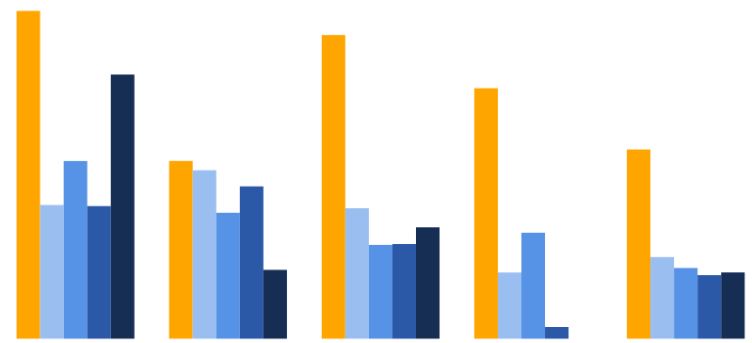
Uninsured Rate By Race
Across all years, racial minorities have been disproportionately impacted by uninsurance
The gap widens further in 2020, with a 1-point increase in the uninsured rate among Black/African Americans and a 7-point increase in the uninsured rate among American Indian/Alaska Natives.
Uninsured Rate Across Race Groups
Denominator: total per race group per year
Uninsured by Race (count)
Race | 2012 | 2015 | 2016 | 2018 | 2020
AIAN* | 2,125 | 1,087 | 2,197 | 1,131 | 3,320
Asian* | 2,687 | 2,913 | 2,683 | 2,098 | 1,670
Black | 14,740 | 5,505 | 4,193 | 4,814 | 5,852
Other* | 1,537 | 859 | 771 | 106 | 0
White | 91,685 | 39,226 | 33,765 | 30,737 | 31,463
Total | 112,774 | 49,590 | 43,608 | 38,887 | 42,305
17.7%
16.4%
14.3%
13.5%
*Unweighted counts <15
9.6%
9.6%
9.1%
10.2%
7.2%
7.2%
8.2%
7.0%
6.8%
6.0%
5.7%
5.1%
5.1%
4.4%
3.7%
3.6%
3.8%
3.4%
3.6%
0%
AIAN Asian Black Other White
Percent of Uninsured Population by Race
Denominator: total # uninsured per year
2020
7.8% 4.0% 13.8% 74.4%
2018
2.9% 5.4% 12.4% 79.0%
2016
5.0% 6.2% 9.6% 77.4%
Notes:
Key Findings:
Over recent months, the COVID-19 pandemic has brought racial and ethnic inequities back to the forefront. We now look at rates of uninsurance across different race groups across all survey years.
Across all years, we find racial minorities are disproportionately impacted by uninsurance.
For example, in 2020…
14.3% of the American Indian/Alaska Native population in RI and 6% of the Black/African American population in RI were uninsured, compared to only 3.6% of the White population (top chart)
Another ways of looking at it…
~8% of the uninsured pop identified as American Indian/Alaska Native, whereas only 1.3% of all Rhode Islanders identified as this race
~14% of the uninsured pop identified as Black/African American, whereas only 9.6% of all Rhode Islanders identified as this race (bottom chart)
In 2020, we saw a widening of this disparity particularly among the AIAN and Black populations (top chart)
General Notes:
Chart 1 (Top) Denominator: total count of RI residents per race group
Chart 2 (Bottom) Denominator: total count of uninsured RI residents
AIAN = American Indian or Alaska Native
‘Other’ race = Pacific Islander and Other (non-specific). Two categories were collapsed together given their very small unweighted sample sizes.
AIAN, Asian, and Other rates should be interpreted with caution given the relatively small unweighted sample sizes for these populations across all years.
AIAN unweighted count in 2020: 78
Asian unweighted count in 2020: 245
Other unweighted count in 2020: 5

Slide 11
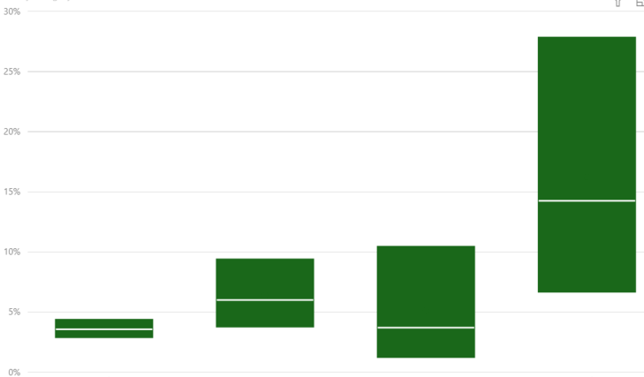
Uninsured Rate By Race & Confidence Intervals
The uninsured rate among American Indians/Alaska Natives (AIAN) is statistically significantly higher than the uninsured rate among Whites
The uninsured rates among the three minority race groups are not statistically significantly different.
The uninsured rate among Blacks and Whites, and the uninsured rate among Asians and Whites are not statistically significantly different.
Uninsured Population, 2020
27.8%
Upper Confidence Interval
Median
14.3%
Lower Confidence Interval
9.4%
10.4%
4.4%
6.0%
6.7%
3.6%
3.8%
3.7%
2.9%
1.3%
White Black Asian AIAN
Notes:
Key Findings:
The uninsured rate among AIANs is statistically significantly higher than the uninsured rate among Whites, but not statistically significantly different from the uninsured rate among Blacks and Asians.
The margin of error for the AIAN and Asian uninsured rate is great than the margin of error for the White and Black uninsured rate due to the relatively small sample sizes for the prior two groups
AIAN unweighted count in 2020: 78
Asian unweighted count in 2020: 245
Black unweighted count in 2020: 551
White unweighted count in 2020: 6,475
General Notes:
AIAN = American Indian or Alaska Native

Slide 12
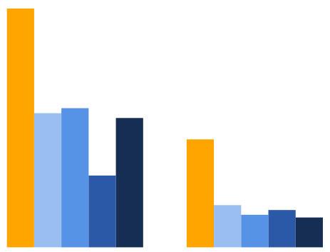
Uninsured Rate By Ethnicity
Across all years, Hispanic/Latinos were more likely to be uninsured than non-Hispanic/Latinos
In 2020, nearly half of the uninsured population identified as Hispanic/Latino, whereas only 16.3% of all Rhode Islanders identified as a member of this ethnic group.
From 2018 to 2020, the uninsured rate increased 5 points among Hispanic/Latinos while it decreased by 0.6 point among non-Hispanic/Latinos.
Uninsured Rate Across Ethnicities
Denominator: total per ethnicity group per year
20.8%
Uninsured by Ethnicity (count)
Hispanic/Latino | 2012 | 2015 | 2016 | 2018 | 2020
Yes | 27,607 | 16,626 | 18,335 | 10,085 | 19,672
No | 85,167 | 32,964 | 25,274 | 28,802 | 22,633
Total | 112,774 | 49,590 | 43,608 | 38,887 | 42,305
11.7%
12.1%
11.3%
9.4%
6.3%
3.7%
2.8%
3.2%
2.6%
Hispanic/Latino Non-Hispanic/Latino
Percent of Uninsured Population by Ethnicity
Denominator: total # uninsured per year
2020
53.5% 46.5%
2018
74.1% 25.9%
2016
58.0% 42.0%
2015
66.5% 33.5%
Notes:
Key Findings:
Now we look at rates of uninsurance across different ethnicity groups across all survey years.
Similarly, we see ethnic minorities are disproportionately impacted by uninsurance.
For example, in 2020, 11.3% of Hispanic/Latinos in RI were uninsured compared to 2.6% of non-Hispanic/Latinos.
Another way of looking at it - nearly half (46.5%) of the uninsured pop identified as Hispanic/Latino, whereas only 16.3% of all Rhode Islanders identified as a member of this ethnic group (bottom chart).
In 2020, we saw an increased disparity between the two groups. While the uninsured rate decreased by 0.6 point for non-Hispanic/Latinos, it jumped by 5 points for Hispanic/Latinos (top chart).
General Notes:
Chart 1 (Top) Denominator: total count of RI residents per ethnicity group
Chart 2 (Bottom) Denominator: total count of uninsured RI residents

Slide 13
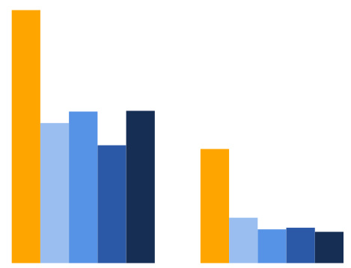
Uninsured Rate Among U.S. vs. Foreign Born
Across all years, those born outside of the U.S. were more likely to be uninsured
In 2020, the uninsured rate among those who are foreign born was 12.7%, whereas the uninsured rate among those born in the U.S. was 2.6%.
From 2018 to 2020, the uninsured rate jumped by nearly 3 points among those who are foreign born, and fell by 0.3 point among those born in the U.S.
Uninsured Rate By Place of Birth
Denominator: total per place of birth group per year
Uninsured by Place of Birth (count)
21.1%
Born in U.S | 2012 | 2015 | 2016 | 2018 | 2020
Yes | 87,150 | 34,507 | 25,215 | 27,437 | 23,453
No | 25,396 | 14,640 | 18,393 | 11,450 | 18,292
Total | 112,546 | 49,147 | 43,608 | 38,887 | 41,745
11.7%
12.6%
12.7%
9.8%
Note: Eligibility for government sponsored insurance and state-provided coverage assistance is tied to immigration status. Only U.S. citizens and non-citizens with green cards are eligible for these programs.
9.5%
3.8%
2.9%
2.6%
2.8%
Foreign Born Born in U.S.
Percent of Uninsured Population by Place of Birth
Denominator: total # uninsured per year
2020
43.8% 56.2%
2018
29.4% 70.6%
2016
42.2% 57.8%
2015
29.8% 70.2%
Notes:
Key Findings:
Now we look at rates of uninsurance across those born in the U.S. versus abroad.
Across all years, those who were born outside of the U.S. are more likely to be uninsured than those born in the U.S.
For example, in 2020, the uninsured rate among those born outside of the U.S. was 12.7%, whereas the uninsured rate among those born in the U.S. was 2.6% (top chart).
Another way of looking at it – nearly half (43.8%) of the uninsured pop were foreign born, whereas only 13.7% of all Rhode Islanders were foreign born (bottom chart).
In 2020, we saw an increased disparity between the two groups. While the uninsured rate decreased by 0.3 point among those born in the U.S., it jumped by nearly 3 points for among those who are foreign born (top chart).
Note, despite the state’s best efforts, it is unlikely the uninsured rate will ever be reduced to 0.
Under current federal and state rules, eligibility for government sponsored insurance and state-provided coverage assistance is tied to immigration status.
E.g. Undocumented residents are not eligible, citizens and non-citizens with green cards are eligible.
General Notes:
Chart 1 (Top) Denominator: all RI residents who were born in the U.S. versus foreign born
Chart 2 (Bottom) Denominator: total count of uninsured RI residents.
National rate comparisons based on citizenship status (not place of birth): “Most of the uninsured (77.0%) are U.S. citizens and 23.0% are non-citizens. However, non-citizens are more likely than citizens to be uninsured. The uninsured rate for recent immigrants, those who have been in the U.S. for less than five years, was 29.6% in 2019, while the uninsured rate for immigrants who have lived in the US for more than five years was 36.3%.” (Kaiser Family Foundation analysis of 2019 American Community Survey, 1-Year Estimates: https://www.kff.org/uninsured/issue-brief/key-facts-about-the-uninsured-population/)

Slide 14
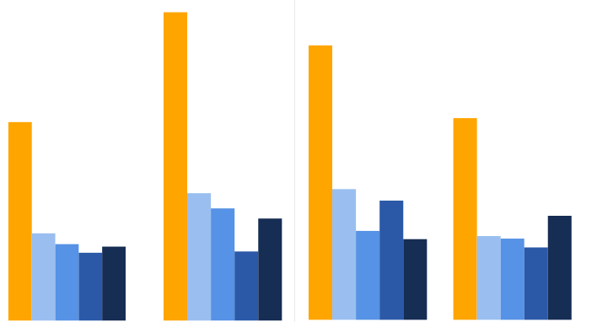
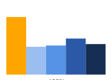
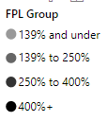
Uninsured Rate Among Different Income Groups
For the first time since 2012, the uninsured rate in RI rose among households with an annual income of under 139% FPL and between 250 to 400% FPL
In 2018, those with household incomes of 139 – 250% FPL experienced the highest uninsured rate. In 2020, those with household incomes of 250 – 400% FPL experienced the highest uninsured rate.
Those with household incomes of >400% FPL experienced the lowest uninsured rates across all years.
Uninsured Rate Among Income Groups (% FPL)
Denominator: total per income group per year
16.9%
Uninsured by Income Level (count)
15.1%
Income | 2012 | 2015 | 2016 | 2018 | 2020
< 139% FPL | 49,583 | 22,714 | 19,837 | 11,168 | 16,268
139 – 250% FPL | 27,326 | 11,245 | 8,182 | 11,010 | 7,425
250 – 400% FPL | 22,256 | 9,146 | 8,909 | 7,267 | 10,641
400%+ FPL | 13,610 | 6,485 | 6,680 | 9,441 | 7,972
State Total | 112,775 | 49,590 | 43,608 | 38,886 | 42,306
10.9%
11.1%
7.0%
7.2%
6.5%
4.8%
6.1%
5.6%
4.6%
5.7%
4.2%
4.0%
3.8%
4.9%
4.4%
4.5%
3.7%
4.0%
3.8%
2.4%
1.9%
2.0%
1.8%
State Average <139% FPL 139 – 250% FPL 250 – 400% FPL >400% FPL
Percent of Uninsured Population by Income Level
Denominator: total # uninsured per year
2020
38.5% 17.6% 25.2% 18.8%
2018
28.7% 28.3% 18.7% 24.3%
2016
45.5% 18.8% 20.4% 15.3%
Notes:
Key Findings:
RI has made significant gains in coverage since the ACA. In 2018, the State uninsured rate reached an all-time low. However, the uninsured rate did not fall ubiquitously. In past years, the uninsured rate remained stable or declined across all FPL groups. In 2018, the uninsured rate in RI rose among households of 139-250% of the Federal Poverty Level (FPL) and 400% FPL.
From 2016 to 2018, the uninsured rate decreased most significantly among those with household incomes of <139% FPL and increased most significantly among those with household incomes of 139 – 250% FPL.
This resulted in a fundamental shift in the income profile of the uninsured population in RI.
In comparison to 2016, a greater share of the uninsured have household incomes between 139-250% FPL and >400% FPL in 2018.
First time since 2012, the >139% FPL and 139 – 250% FPL groups constituted a fairly equal portion (~28%) of the uninsured population in 2018.
In 2020, we saw the emergence of a new trend, perhaps spurred by the COVID pandemic
For the first time since 2012, the uninsured rate rose among households with an annual income of under 139% or between 250 to 400% FPL. The reason for this phenomenon is not known, but hypothesized to be linked to disproportionate rates of job loss among different income groups due to the pandemic, particularly among low-wage earners and those with higher paying full-time positions who may have loss ESI along with their jobs
A potential contributor for 0.4 point decrease in the 2020 uninsured rate among household above 400% FPL: A new state program was implemented in 2020 to bring down premium costs for those who were previously not eligible for HSRI subsidies
General Notes:
Why did the uninsured rate not increase among all income groups over <139% FPL?
We cannot tell for certain based on the data that is available. We are unable to discern between those who are uninsured due to an inability to pay for the cost of coverage, versus those who are uninsured because they choose to be uninsured (e.g. because they perceive the cost to be too high, or they are unsatisfied with the quality, choice, and/or coverage that is provided by available plans)
What we do know is that the problem of uninsurance is impacting a greater percentage of those whose incomes exceed the Medicaid eligibility thresholds, than in most past years
Chart 1 (Top) denominator: all Rhode Island residents within each FPL group
Chart 2 (Bottom) denominator: all uninsured in Rhode Island

Slide 15
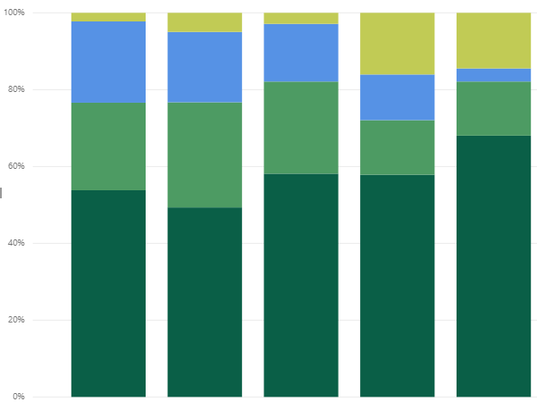
Coverage Gap
From 2012 through 2020, the number of residents who reported a coverage gap
steadily declined
From 2018 to 2020, the rate of individuals experiencing longer-term gaps decreased.
In 2020, over two-thirds of individuals with a coverage gap were uninsured for 3 months or less.
Length of Time Uninsured
2.2%
5.0%
2.9%
15.0%
16.1%
14.5%
21.2%
18.3%
3.4%
11.9%
14.1%
22.8%
24.0%
14.2%
27.4%
58.1%
68.0%
53.8%
49.5%
57.9%
2012 2015 2016 2018 2020
Total with Coverage Gap (Count)
2012 | 2015 | 2016 | 2018 | 2020
40,176 | 40,108 | 32,477 | 26,534 | 19,358
Notes:
Key Findings:
From 2018 to 2020, the number of RI residents who reported a coverage gap of a year or less continued to decline.
In 2020, nearly 67% of residents who had experienced an interruption in coverage were without coverage for up to 3 months, 14% were without coverage for 4 – 6 months, about 3% were without coverage for 7 – 12 months, and 14% were without coverage for over a year.
General Notes:
Denominator: all Rhode Island residents who are currently insured, but had previously been without coverage for a period of time; this does not include residents who have never had insurance, residents who are uncertain if they’ve had a gap in coverage, or residents who did not report any interruptions to their coverage

Slide 16
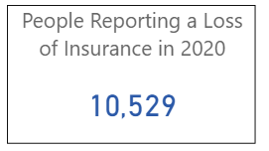
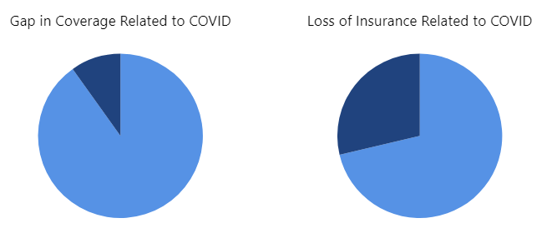
Impact of COVID on Insurance Coverage
The majority of RI residents who experienced a short-term gap in insurance or recent loss of insurance did not attribute the interruption in coverage to the COVID-19 pandemic
Less than 10% of those who experienced a short-term gap in coverage in the past year attributed the gap to COVID.
Less than one-third of those who experienced a recent loss of insurance attributed the loss to COVID.
*
**
Yes
9.8%
Yes
28.7%
No
90.2%
No
71.3%
*Gap in coverage: question was asked of all respondents currently with coverage, but without coverage at some
time in the past 12 months for 2 months or less
**Loss of coverage: question was asked of all respondents currently without coverage and who have been
uninsured for 2 months or less
Notes:
Key Findings:
From 2018 to 2020, the number of RI residents who reported a coverage gap of a year or less continued to decline.
In 2020, nearly 67% of residents who had experienced an interruption in coverage were without coverage for up to 3 months, 14% were without coverage for 4 – 6 months, about 6% were without coverage for 6 – 12 months, and 14% were without coverage for over a year.
General Notes:
New survey question added in 2020
Gap in coverage: question was asked of all respondents currently with coverage, but without coverage at some time in the past 12 months for 2 months or less
Loss of coverage: question was asked of all respondents who stated they were currently without coverage and had been uninsured for 2 months or less
Note, the gap in coverage population could include those who experienced a loss of insurance prior to the COVID-19 pandemic

Slide 17
Reasons for Uninsurance
Among those without coverage, high premium costs and job loss were the most common reasons for uninsurance
In 2020, the most commonly reported reasons for being uninsured were unaffordable premiums, loss of a job, and loss of Medicaid coverage. This is on par with the top three reasons reported in 2018.
In alignment with the economic downturn caused by the COVID-19 pandemic, job loss, loss of eligibility for employer-sponsored insurance (ESI) due to a reduction in work hours, and loss of option of ESI through employers, all increased as reasons for uninsurance.
Reported Reasons for Uninsurance
37.6%
32.3%
30.6%
26.4%
27.7%
29.4%
25.6%
25.1%
26.2%
26.4%
26.0%
20.7%
21.6%
19.4%
20.6%
19.2%
18.3%
16.1%
16.0%
15.3%
12.4%
11.9%
10.9%
10.0%
5.5%
Person with insurance lost job
No longer eligible for ESI due to a reduction in work hours
Employer stopped offering coverage
Premium too high
Lost Medicaid coverage
Total Uninsured (Count)
2012 | 2015 | 2016 | 2018 | 2020
112,774 | 49,591 | 43,609 | 38,887 | 42,305
Notes:
General Notes:
Respondents were asked to respond YES/NO to a set list of reasons. Option for respondents to select more than one reason.
Chart denominator: all uninsured Rhode Island residents

Slide 18
Eligibility for Medicaid and HSRI Coverage
Of those who were uninsured in 2020, 40% were potentially eligible for a subsidy on the Exchange and 33% were potentially eligible for Medicaid, based on their reported household income
Segmenting out the uninsured non-elderly adult population, 49% of those aged 18-35 were potentially eligible for a subsidy on the Exchange, in comparison to 38% of those aged 36-64. Over one-third of both groups were potentially eligible for Medicaid.
Among Hispanic/Latinos, 38% were potentially eligible for a subsidy and 49% were potentially eligible for Medicaid. Among non-Hispanics, 49% were potentially eligible for a subsidy and 26% were potentially eligible for Medicaid.
Potential Eligibility for Medicaid or Exchange Subsidies among Uninsured
48.9%
48.8%
48.5%
43.9%
36.4%
37.7%
36.8%
37.5%
35.8%
26.3%
24.9%
26.7%
19.8%
13.4%
14.7%
Total Uninsured Population
Hispanic or Latino Population
Non-Hispanic Population
Age 18 - 35
Age 36 - 64
Total Uninsured (count): 42,305
Notes:
Key Findings:
What portion of the uninsured population is addressable by Medicaid and HSRI?
In 2020, of those who were uninsured, 33% were potentially eligible for Medicaid, 40% were potentially eligible for a subsidy on the Exchange, and 27% were not eligible for either.
Segmenting the uninsured non-elderly adult population, 37% of those aged 18-35 were eligible for Medicaid in comparison to 26% of those aged 36-64.
49% of those aged 18-35 were eligible for a subsidy on the Exchange in comparison to 38% of those aged 36-64.
Among the uninsured, Hispanic/Latinos were more likely to be eligible for Medicaid and less likely to be eligible for a subsidy than non-Hispanic/Latinos.
General Notes:
Chart denominator: all uninsured Rhode Island residents; all insured Rhode Island residents within the designated ethnicity or age group
Those with household incomes >400% FPL are eligible for a HSRI plan, but not an HSRI subsidy
Eligibility criteria for coverage assistance programs in RI:
Medicaid: Covers low-income adults, children, seniors, persons with disabilities, pregnant women, children in foster care and former foster youth up to age 26. Income thresholds: adults with incomes up to 133% FPL, pregnant women with household incomes up to 253% FPL, children with household incomes up to 261% FPL.
Federal tax credit: Assistance with monthly premium cost. Income threshold: families and individuals not eligible for Medicaid and have income below 400% FPL.
Cost-sharing subsidy: Assistance with copays, deductibles, and co-insurance. Income threshold: Individuals and families with income below 250% FPL.
RIte Share: Assistance with partial or full cost of employer-based insurance. Income threshold: Families with income up to 133% FPL, pregnant women with income up to 253% FPL, children up to age 19 with income up to 261% FPL. There is cost-sharing for families with income over 150% FPL.
Program Eligibility Source: HSRI (https://healthyrhode.ri.gov/HIXWebI3/healthcare-faq)

Slide 19
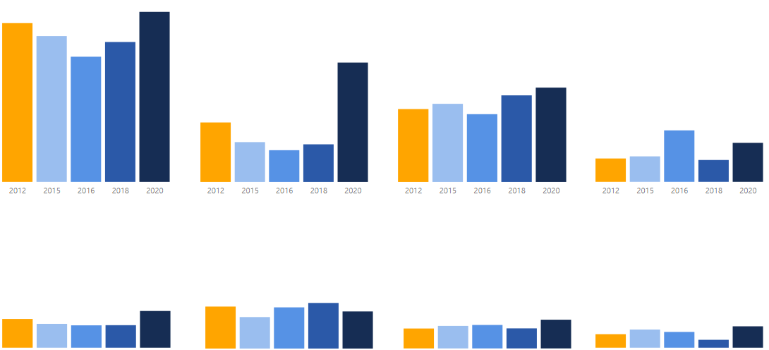
Reason for Non-Enrollment in Medicaid or HSRI
In 2020, concerns about the ‘cost of coverage’ and ‘quality of care’ were the primary reasons for non-enrollment in any State sponsored insurance program among those who were uninsured and potentially eligible
Over half cited concerns about the ‘cost of coverage’ as the reason for non-enrollment. This trend persisted across all years.
In comparison to 2018, the portion of individuals concerned about the quality of care rose by 29 points.
Reasons Uninsured did not Enroll in Medicaid or the HSRI Subsidy Program
60.7%
Total Uninsured and Potentially Eligible for Medicaid or HSRI Subsidy (Count)
56.0%
51.5%
44.2%
49.4%
41.9%
26.5%
29.3%
31.9%
Year | Count
2012 | 89,555
2015 | 36,675
2016 | 31,644
2018 | 26,795
2020 | 30,790
20.9%
24.7%
23.0%
14.0%
13.2%
22.3%
16.9%
11.2%
10.1%
11.1%
9.5%
Worried cost would be too high
Concerned about the quality of care
Household makes too much money
Employer offers insurance
15.9%
14.2%
13.9%
15.4%
12.6%
12.5%
10.3%
9.7%
9.8%
10.7%
8.6%
9.8%
10.2%
8.7%
12.5%
7.9%
9.3%
5.9%
6.9%
3.4%
Concerned provider would treat me differently
Concerned I would not get the providers I want
Don’t need insurance
Don’t want to be on public assistance
Notes:
Key Findings:
In 2020, concerns about ‘the cost of coverage’ persisted as the top reason why those who were uninsured and eligible for Medicaid or a subsidy on the Exchange, did not enroll.
Among all uninsured who were potentially eligible for Medicaid or an HSRI subsidy, over half cited concerns about the ‘cost of coverage’ as the reason for non-enrollment.
Shifts from 2018:
Portion of individuals concerned about the quality of care rose by 29 points
Portion of individuals concerned about employer’s offer of insurance rose by 7 points
Portion of individuals who didn’t want to be on public assistance rose by 6 points
Portion of individuals concerned about a shift in provider treatment by 5 points
Portion of individuals who didn’t want insurance rose by 4 points
Portion of individuals concerned about their household making too much money rose by 3 points
Portion of individuals concerned about provider choice dropped by 3 points
**Note: exact magnitude of change may differ when the confidence intervals of each data point are taken into consideration
General Notes:
Respondents were asked to respond YES/NO to a set list of reasons. Option for respondents to select more than one reason.
Denominator: all uninsured Rhode Island residents who were eligible for Medicaid or an HSRI subsidy, but did not enroll; the uninsured with a household income >400% FPL are excluded (these individuals would not be eligible for a HSRI subsidy)

Slide 20
SECTION 6. State Mandate
The state’s newly implemented coverage mandate could help to further reduce RI’s uninsured rate
In 2020, nearly 73% of those who are currently uninsured noted the mandate will influence their decision to obtain coverage in the future.
It is important to note, nearly half of the uninsured population was not aware of the new state mandate. Additional outreach and educational efforts are recommended.
Asked of those who are currently uninsured…
Are you aware of the new state mandate that requires all residents to have health insurance coverage or pay a penalty?
Will the mandate influence your decision to obtain health insurance in the future?
How important was the penalty in your decision to buy (or not buy) health insurance for uninsured family members?
72.8%
53.6%
46.4%
39.4%
27.2%
26.9%
19.4%
14.3%
Yes No
Yes No
Very important
Somewhat important
Not very important
Not at all important
Total Uninsured (count): 42,305
Notes:
General Notes:
New survey question added in 2020
Denominator: all currently uninsured Rhode Islanders

Slide 21
SECTION 7. Underinsurance
What is Underinsurance?
This term applies to an individual covered by insurance and fulfills one of three criteria, as defined by the Commonwealth Fund:
Out-of-pocket costs over the past 12 months, excluding premiums, for families with incomes of 200% FPL or greater, was equal to at least 10% of household income;
Out-of-pocket costs over the past 12 months, excluding premiums, for families with incomes less than 200% FPL, was equal to at least 5% of household income; OR
The deductible was at least 5% of household income.
Residents were not asked whether or not they were underinsured. Instead, the determination was made based upon responses to questions on income, out-of-pocket costs, and deductible costs.
This report does not include underinsurance data from 2012. The criteria used in that year to identify the underinsured differed from the criteria used in 2015, 2016, 2018, and 2020.
Household Income for a US Family of Four, 2020
 | % of FPL
 | 100% | 200% | 300% | 400%
Total Household Income | $26,200 | $52,400 | $78,600 | $104,800
5% of Total Household Income | $1,310 | $2,620 | $3,930 | $5,240
10% of Total Household Income | $2,620 | $5,240 | $7,860 | $10,480
*For the 48 contiguous States and the District of Columbia
Source: US Department of Health and Human Services
Notes:
Definition of underinsured
This term applies to an individual covered by insurance and fulfills one of the three criteria, as defined by the Commonwealth Fund:
1) The out-of-pocket costs over the past 12 months, excluding premiums, for families with incomes of 200% FPL or greater, was equal to at least 10% of household income;
2) The out-of-pocket costs over the past 12 months, excluding premiums, for families with incomes less than 200% FPL, was equal to at least 5% of household income; or
3) The deductible was at least 5% of household income.
This report does not include underinsurance data from 2012, as the criteria used in that year by Market Decisions to identify this population differed from the criteria used in 2015, 2016, and 2018.
Source: US Department of Health and Human Services (https://aspe.hhs.gov/poverty-guidelines)

Slide 22
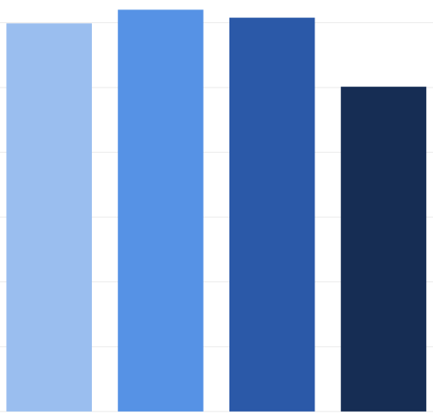
The Underinsured Population
RI’s underinsurance continued to decline through 2020
From 2018 to 2020, the underinsurance rate among all covered residents fell by 5.3 points.
25.1% of residents with coverage were considered underinsured by the Commonwealth Fund criteria in 2020, in comparison to 30.4% of residents in 2018.
Rhode Island Underinsured Rate
29.9%
31.0%
30.4%
Total Underinsured
25.1%
Year | Count
2015 | 296,285
2016 | 309,773
2018 | 306,615
2020 | 251,411
Notes:
Key Findings:
From 2018 to 2020, the underinsurance rate fell by 5.3 points.
Among all residents who had coverage in 2020, 25.1% were underinsured by the Commonwealth Fund definition.
General Notes:
Chart denominator: all insured Rhode Island residents who were underinsured in accordance to the CW criteria; coverage types include Medicaid, Medicare, private insurance, and military insurance

Slide 23
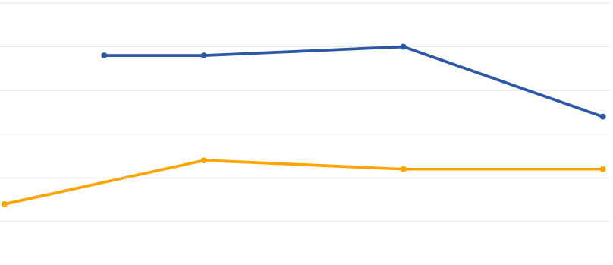
Underinsured Rate Among Adults Aged 19 – 64
From 2018 to 2020, the underinsured rate among adults aged 19-64 years remained steady nationally but dropped by 8 points in RI
The underinsured rate among non-elderly adults in RI rose slightly from 2016 to 2018, but meaningfully decreased over the last two years.
In 2020, under one-third of non-elderly adults in RI were underinsured.
Underinsured Rate Among Adults, Age 19 - 64
40%
35%
30%
25%
20%
15%
10%
35%
Total Underinsured in RI
Aged 19-64
34%
34%
Year | Count
2015 | 213,722
2016 | 212,461
2018 | 219,832
2020 | 179,578
27%
22%
17%
21%
21%
2014 2015 2016 2017 2018 2019 2020
National Statistic Source: Commonwealth Fund Biennial Health Insurance Surveys
Notes:
Key Findings:
Among adults (aged 19-64 years), the US and RI underinsured rate both increased by 1 point since 2016.
The magnitude of change is amplified when the overall size of the US non-elderly adult population versus the overall RI non-elderly adult population are taken into account.
In 2018, the national non-elderly adult uninsured rate was 21%, whereas RI’s rate was 35%.
In 2020, the national non-elderly adult uninsured rate was unchanged at 21%, whereas RI’s rate dropped to 27%.
General Notes:
The adult nonelderly population is of particular interest because the majority are ineligible for Medicare and Medicaid, and reliant on subsidies and private plans for coverage. This is the uninsured population that is most addressable by EOHHS and HSRI sponsored programs.
Chart denominator: all US and Rhode Island residents, aged 19-64 years
National Statistic Source: Commonwealth Fund Biennial Health Insurance Surveys, 2012, 2014, 2016, 2018, and 2020 (https://www.commonwealthfund.org/publications/surveys/2020/aug/2020-biennial-health-insurance-survey)

Slide 24
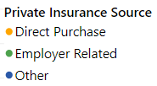
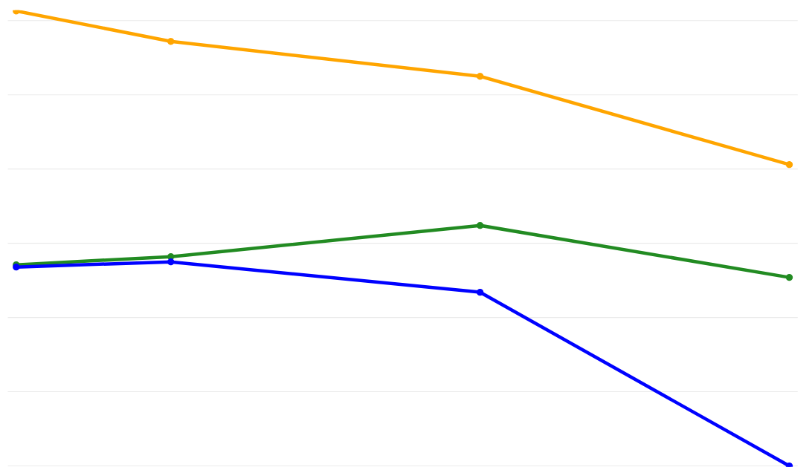
Underinsurance Rate Among Privately Insured
Among those with private coverage, the underinsurance rate dropped by nearly 7 points
from 2018 to 2020
While the national underinsured rate held steady for work-based insurance and increased among those with direct purchase coverage, RI’s underinsured rate declined across all sources of private coverage over the two-year period.
Rhode Island Underinsured Rate Among Privately Insured, 2015 – 2020
Underinsurance Rate by Private Insurance Source, 2020
61.3%
60%
50%
40%
30%
20%
10%
0%
57.2%
52.5%
Total with Private Coverage who are Underinsured
32.4%
40.6%
Year | Count
2015 | 171,696
2016 | 173,877
2018 | 186,240
2020 | 149,573
26.8%
28.2%
23.4%
25.4%
27.1%
27.5%
0%*
2015 2016 2017 2018 2019 2020
*Sample size for underinsured RI residents with ‘Other’ private insurance in 2020 = 0
Notes:
Key Findings:
From 2016 to 2018, RI’s underinsured rate among those with private insurance increased by 2.6 points, propelled by a rise in underinsurance among those with employer-related coverage.
In comparison, from 2018 to 2020, that state’s underinsured rate among those with private insurance fell by nearly 7 points.
General Notes:
‘Other’ types of insurance include union-based plans, school sponsored plans, COBRA, etc.
Chart denominator: all privately insured Rhode Island residents who were underinsured in accordance to the CW criteria
National underinsured trends among the privately insured: Commonwealth Fund Biennial Affordability Report (https://www.commonwealthfund.org/sites/default/files/2020-08/PDF_Collins_looming_crisis_affordability_biennial_2020_exhibits.pdf)

Slide 25
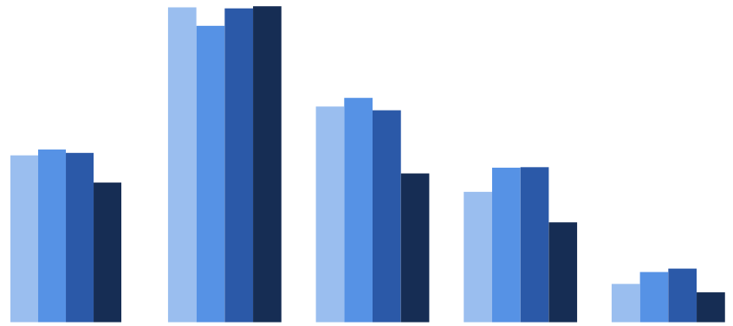
Underinsured Rate Among Different Income Groups
In 2020, the underinsured rate in RI dropped across nearly all income groups
In comparison to 2018, nearly all income groups experienced a meaningful decrease in underinsurance in 2020. The exception was those with household incomes of <139% FPL.
Across all years, those with household incomes of <139% FPL experienced the highest rates of underinsurance. While the rate declined from 2015 to 2016, it increased from 2016 through 2020. Those with incomes less than 139% FPL represented over 50% of the underinsured population across all years.
Underinsured Rate by Income Level (% FPL)
Underinsured by Income Level (count)
56.4%
53.2%
56.3%
56.9%
Income | 2015 | 2016 | 2018 | 2020
< 139% FPL | 171,355 | 161,399 | 160,143 | 156,045
139 – 250% FPL | 56,381 | 64,275 | 59,884 | 42,843
250 – 400% FPL | 44,465 | 53,022 | 48,924 | 31,525
400%+ FPL | 24,084 | 31,077 | 37,664 | 20,998
State Total | 296,285 | 309,773 | 306,615 | 251,411
38.7%
40.1%
37.8%
31.0%
30.4%
29.9%
26.6%
27.5%
28.0%
25.1%
23.3%
18.1%
6.9%
9.0%
9.6%
5.3%
State Average <139% FPL 139 – 250% FPL 250 – 400% FPL >400% FPL
Share of Underinsured by Income Level
2020
62.1% 17.0% 12.5% 8.4%
2018
52.2% 19.5% 16.0% 12.3%
2016
52.1% 20.7% 17.1% 10.0%
Notes:
Key Findings:
In comparison to 2018, nearly all income groups experienced a decreased rate of underinsurance in 2020. The exception was individuals with household incomes of <139%FPL.
Across all years, those with household incomes of <139% FPL experienced the highest rates of underinsurance (over 50%). While the rate declined from 2015 to 2016, it increased from 2016 through 2020.
General Notes:
Chart 1 (Top) denominator: all insured Rhode Island residents; uninsured residents are excluded
Chart 2 (Bottom) denominator: all underinsured Rhode Island residents

Slide 26
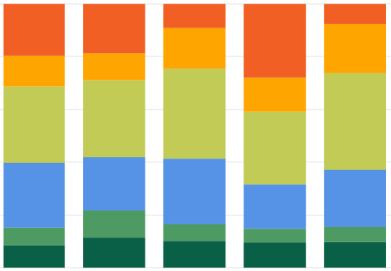
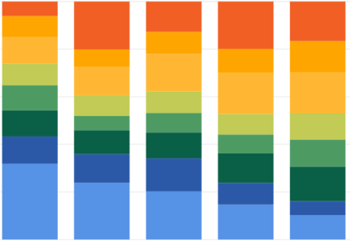
SECTION 8. Cost of Care
From 2018 to 2020, average monthly premium costs dropped, while average annual deductible costs remained relatively stable
In 2020, 74% of insured residents paid a monthly premium of $500 or less, compared to 59% of residents in 2018.
In comparison, deductible amounts remained relatively unchanged during same period. In 2020 and 2018, ~47% of insured residents paid an annual deductible of over $2,000.
Monthly Premium Amount
Annual Deductible Amount
19.0%
9.3%
7.7%
6.1%
12.7%
19.8%
28.0%
8.8%
20.1%
19.9%
16.6%
15.3%
18.5%
11.2%
9.3%
11.6%
9.9%
7.3%
10.1%
13.0%
13.0%
9.1%
11.9%
15.7%
29.1%
33.9%
10.6%
8.7%
9.1%
17.3%
17.3%
28.9%
36.9%
27.3%
10.9%
6.0%
8.2%
8.6%
11.0%
11.4%
10.1%
10.9%
7.9%
11.4%
24.6%
20.3%
24.9%
21.3%
12.0%
13.8%
12.4%
16.9%
9.1%
14.6%
6.4%
10.3%
6.5%
5.0%
5.8%
31.9%
23.9%
5.9%
8.7%
11.3%
10.2%
9.7%
9.9%
20.3%
14.7%
10.2%
2012 2015 2016 2018 2020
2012 2015 2016 2018 2020
Year | 2012 | 2015 | 2016 | 2018 | 2020
Count of Insured with a Premium and Deductible | 590,402 | 574,665 | 558,111 | 558,322 | 547,379
Notes:
General Notes:
Premium: the amount of money an individual pays every month for an insurance policy
Deductible: the amount of money an insured individual must pay out-of-pocket each year before an insurance provider will pay any expenses
Chart denominators: all insured residents who reported paying a premium and deductible

Slide 27
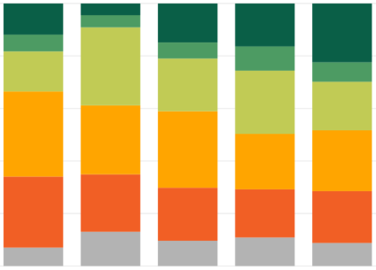
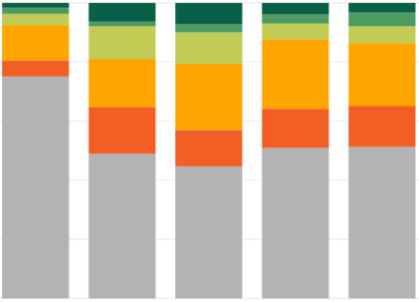
HSA Contributions
Since 2012, the portion of insured individuals with HSAs has continued to grow; while individual contributions on average modestly grew, employer contributions on average did not change meaningfully
In comparison to 2018, the percent of insured residents who contribute something to their HSA rose by 2 points, with an increasing portion of individuals contributing between $1 to $2,000 and $4,000 or more.
Across the same time period, the percent of employers who contributed nothing to individuals’ HSAs rose by 0.4 point, the percent contributing $1 to 2,000 fell by 1.7 points, and the percent contributing over $2000 rose by 1.3 points.
% of Insured with an HSA
16.0% 21.7% 21.9% 24.9% 29.1%
Individual HSA Contribution Amounts
Employer HSA Contribution Amounts
11.9%
4.5%
2.1%
6.4%
7.1%
3.8%
3.3%
4.6%
14.8%
16.4%
22.4%
3.9%
5.4%
5.8%
6.4%
6.1%
11.8%
11.2%
10.7%
15.3%
29.7%
9.2%
7.4%
5.4%
16.1%
23.4%
21.2%
20.1%
22.4%
24.1%
18.5%
15.8%
13.3%
13.8%
32.4%
26.3%
12.3%
29.1%
21.1%
23.2%
75.1%
49.0%
44.8%
50.9%
51.3%
27.0%
21.9%
20.2%
18.4%
19.8%
7.0%
13.1%
9.6%
10.9%
8.8%
2012 2015 2016 2018 2020
2012 2015 2016 2018 2020
Year | 2012 | 2015 | 2016 | 2018 | 2020
Count of Insured with an HSA | 94,358 | 124,679 | 122,173 | 137,116 | 159,433
Notes:
General Notes:
HSA (health saving account): allows individuals to set aside pre-tax dollars to pay for qualified medical expenses; only individuals with an HDHP are eligible for an HSA
HDHP (high deductible health plan): defined by the IRS as a plan with a deductible of at least $1,350 for an individual or $2,700 for a family (https://www.healthcare.gov/glossary/high-deductible-health-plan)
Chart 1 (Top) denominator: all insured Rhode Island residents who reported having an HSA
Charts 2 & 3 (Bottom) denominators: all insured Rhode Island residents who reported having an HSA, provided information on their and/or their employer’s contributions, and knew how much was contributed
National HSA trends:
2020 mid-year statistics from Devenir (https://f.hubspotusercontent00.net/hubfs/392606/4563eh5r.pdf);
2018 report from America’s Health Insurance Plans, AHIP (https://www.ahip.org/more-americans-choose-a-health-savings-account/)

Slide 28
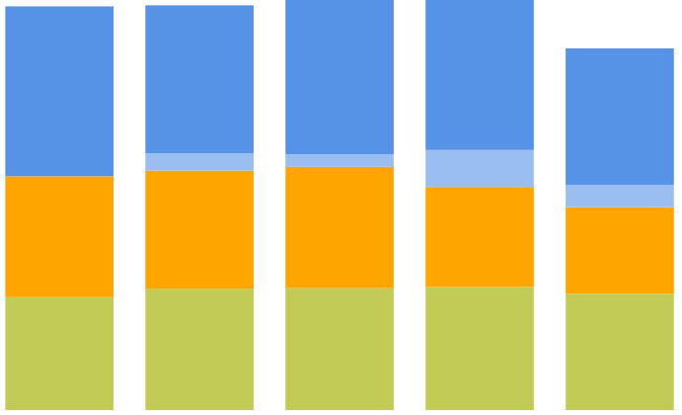
Out-of-Pocket Costs
After steadily rising from 2012 to 2018, out-of-pocket medical costs dropped in 2020
In 2020, Rhode Island residents spent an average of $2,124 out-of-pocket for all medical expenses. Outside of general medical expenses, residents spent the most out-of-pocket for dental and vision care, followed by prescriptions, and mental health services.
From 2018 to 2020, the average out-of-pocket cost for dental and vision care dropped by $39, the average cost of prescriptions dropped by $80, the average cost of mental health care by $86, and the average cost of general care by $125.
A portion of the observed reductions in cost is likely attributed to a general decline in non-urgent service utilization rates during the earlier months of the COVID-19 pandemic.
Average Out-of-Pocket Spending
All Medical Expenses
Average Out-of-Pocket Spending
2012
$2,370
$997
$869
$906
$926
2015
$2,376
$801
$100
$74
$217
2016
$2,409
$131
$710
$693
$713
$588
$508
2018
$2,454
2020
$2,124
$663
$713
$715
$723
$684
2012
2015
2016
2018
2020
Notes:
Key Findings:
From 2012 to 2018, Rhode Island residents have had to spend an increasing amount out-of-pocket for medical expenses. In 2020, we see a shift in this trend.
In 2020, Rhode Island residents spent an average of $2,124 out-of-pocket for all medical expenses. Outside of general medical expenses, residents spent the most out-of-pocket for dental and vision care (an average of $684), followed by prescriptions (an average of $508), and mental health care (an average of $131).
After consistently increasing across past years, the average out-of-pocket cost for dental and vision care dropped from $723 in 2018 to $684 in 2020.
From 2018 to 2020, the average out-of-pocket cost for prescriptions fell from $588 to $508, while the average out-of-pocket cost for mental health services fell from $217 to $131.
General Notes:
Chart denominator: all Rhode Island residents, insured and uninsured
National shifts in health spending and utilization during the COVID-19 pandemic: Peterson-KFF Health System Tracker Report (https://www.healthsystemtracker.org/chart-collection/how-have-healthcare-utilization-and-spending-changed-so-far-during-the-coronavirus-pandemic/#item-start)

Slide 29
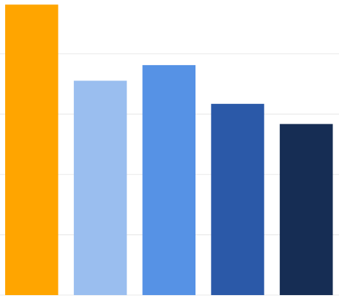
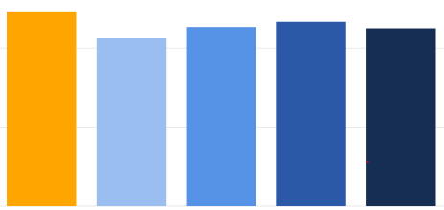
Cost Burden
The proportion of residents who received a medical bill greater than $500 and the proportion of residents who reported difficulty paying a bill fell in 2020
In 2020, slightly over 11% of residents reported receiving a medical bill greater than $500 in the past year. This represented a modest decrease since 2018.
From 2016 through 2020, the proportion of residents who reported difficulty paying a medical bill continuously dropped, declining by 1.7 points over the two years.
Received a Single Medical Bill Over $500 Out-of-Pocket
Had Problems Paying for Medical Bills
24.1%
12.3%
10.6%
11.3%
11.7%
11.3%
17.8%
19.1%
15.9%
14.2%
2012 2015 2016 2018 2020
2012 2015 2016 2018 2020
Year | 2012 | 2015 | 2016 | 2018 | 2020
Count of Individuals, Received Bill >$500 | 128,047 | 110,363 | 118,250 | 122,269 | 117,711
Year | 2012 | 2015 | 2016 | 2018 | 2020
Count of Individuals, Problem Paying Bills | 249,997 | 184,594 | 198,767 | 166,106 | 148,263
Notes:
Key Findings:
In 2020, slightly over 11% of residents reported receiving a medical bill greater than $500 in the past year. This represented a modest decline since 2018.
From 2018 to 2020, the proportion of residents who reported difficulty paying a medical bill dropped by 1.7 points to under 14% in 2020.
Possible mitigating factors for difficulty paying medical bills:
Rise in average household income over the years
People are now acclimated to high bills and have budgeted better in preparation for them?
General Notes:
Chart denominator: all Rhode Island residents

Slide 30
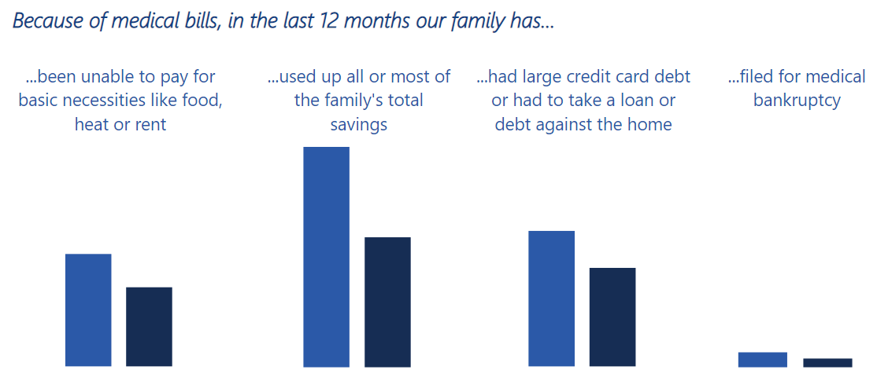
Financial Difficulties Due to Medical Bills
From 2018 to 2020, the portion of RI residents receiving catastrophic medical bills declined
In 2020, the portion of residents who were unable to pay for necessities in the past 12 months due to medical bills fell by around 1 point, those who had to use up most or all their savings fell by 4 points, those who had to take on significant debt fell by over 1 point, and those who had to file for bankruptcy fell by 0.2 point.
8.6%
4.7%
4.9%
4.1%
3.6%
2.9%
0.5%
0.3%
2018 2020
2018 2020
2018 2020
2018 2020
Year | 2018 | 2020
State Population | 1,047,840 | 1,045,523
Notes:
Key Findings:
While the overall percentage of residents facing catastrophic medical bills is relatively low and falling, each individual experiencing these immense difficulties matters and continued efforts are required to further lower current rates.
General Notes:
New question added in 2018.
Chart denominator: all Rhode Island residents per year

Slide 31
SECTION 9. Impact of Cost on Access
The proportion of residents who reported foregoing care because they could not afford it dropped across nearly all care types from 2018 to 2020
Overall, only a small proportion of residents reporting foregoing any type of care due to expense in 2020, ranging from 1.6% for mental health care to 5.6% for dental care.
Across all years, residents were the most likely to forgo dental care and the least likely to forgo mental health care due to expense.
Percent of Residents Forgoing Types of Care due to Expense
 | 2012 | 2015 | 2016 | 2018 | 2020
Mental Health Care | 25,780 | 13,427 | 16,152 | 16,577 | 16,982
Medical Care | 51,149 | 33,364 | 37,203 | 27,230 | 20,469
Diagnostic Tests | 40,940 | 28,805 | 30,118 | 31,120 | 19,997
Prescription Medications | 57,108 | 41,762 | 47,314 | 45,777 | 32,447
Dental Care | 97,839 | 71,179 | 77,432 | 76,589 | 58,066
State Total | 272,816 | 188,537 | 208,219 | 197,293 | 147,961
9.4%
6.8%
7.4%
7.3%
4.9%
5.5%
5.6%
3.9%
4.0%
4.5%
4.4%
3.2%
3.6%
2.5%
2.6%
2.8%
2.9%
3.0%
3.1%
1.6%
1.6%
1.6%
2.0%
1.9%
1.3%
Mental Health Care Medical Care Diagnostic Tests Prescriptions Dental Care
Notes:
Key Findings:
The proportion of residents who reported foregoing care because they could not afford dropped from 2018 to 2020, across most care types. This could be attributed to a reduction in the fairly steady coverage rates and reduction in underinsured rates.
Overall, only a small proportion of residents reporting foregoing any type of care due to expense in 2020, ranging from 1.6% for mental health care to 5.6% for dental care.
Across all years, residents were the most likely to forgo dental care and the least likely to forego mental health care due to expense.
General Notes:
Chart denominator: all Rhode Island residents

Slide 32
SECTION 10. Glossary
Term | Definition
ACA | The Affordable Care Act. Enacted in 2010, the ACA expanded coverage to millions of previously uninsured people through the expansion of Medicaid (implemented in RI in 2014) and the establishment of State Health Insurance Exchanges (implemented in RI in 2013).
COVID-19 | Coronavirus. An infectious disease first identified in December 2019 which resulted in a global pandemic, directly impacting the U.S. beginning in March 2020 with significant ongoing health, economic, and social impacts.
Deductible | The amount of money an insured individual must pay out-of-pocket before an insurance provider will pay any expenses.
ESI | Employer-Sponsored Insurance
FPL | Federal Poverty Level. The incomes are set by the US Department of Health and Human Services.
HSA | Health Savings Account
HSRI | Health Source Rhode Island is the state-run exchange. The exchange negotiates directly with payors to establish health and dental insurance plans and enables RI residents to purchase coverage via a marketplace.
Medicaid | A joint federal and state program that provides healthcare coverage to some low-income people, families and children, pregnant women, the elderly, and people with disabilities. Rhode Island began its expansion of Medicaid in 2014.
Medicare | A federally funded, national health insurance program that provides coverage for Americans aged 65 and older.
Other (race) | A racial category that includes responses from those who identify as Pacific Islander or Other.
Out-of-Pocket Expenses | The amount of money an individual pays for healthcare services which are NOT covered by any insurance or special assistance programs. This DOES NOT include the premium that an individual pays for his/her insurance coverage.
Premium | The amount of money an individual pays for an insurance policy.
Private Insurance | Any health insurance plan or program that is sponsored by an employer or a company like Blue Cross. This DOES NOT include plans or programs that are state or federally sponsored, such as Medicare or Medicaid.
Underinsured | This term applies to an individual covered by insurance and fulfills one of the three criteria, as defined by the Commonwealth Fund The out-of-pocket costs over the past 12 months, excluding premiums, for families with incomes of 200% FPL or greater, was equal to at least 10% of household income. The out-of-pocket costs over the past 12 months, excluding premiums, for families with incomes less than 200% FPL, was equal to at least 5% of household income. The deductible was at least 5% of household income.
Uninsured | This term refers to residents who did not have health insurance coverage at the time of the survey administration.

Slide 33
SECTION 11. Appendix
For additional data resources, visit: https://healthsourceri.com/surveys-and-reports/
Interactive data dashboards
Data compendiums
Compendium FAQs
Technical documents
Additional areas of data exploration include:
Preventive/routine care, ED, and mental health service utilization
Quality of care
Dental coverage
Prescription medication coverage
Medicaid coverage and enrollee experience

